Slide 1
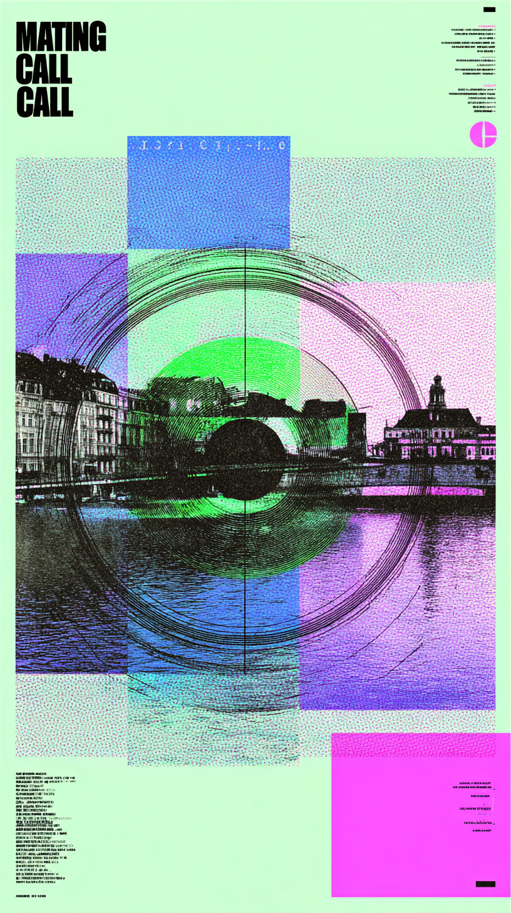
MATING CALL
Interactive Installation & Conceptual App
By George Kerasias (40283826) & Philippe Beauchemin (40337391)
Faculty of Fine Arts | CART 398 Final Project Proposal
An interactive dating experience that replaces swipes and chats with sounds and gestures — exploring the boundaries between algorithmic desire and embodied ritual.

Slide 2



Refined Concept After Feedback
"Mating Call" reimagines online dating through biological signaling and embodied performance. It critiques how dating apps optimize behavior, replacing intimacy with machine-legible performance.
"From algorithmic match to embodied ritual."
The updated concept clarifies the two-step ML pipeline — personalization leading to performance evaluation — and introduces a more immersive interface flow that bridges digital profiling with physical expression.
Swiping
Gesture
Connection
Digital selection
Physical performance
Mating Call

Slide 3

Theme & Artistic Question
Theme
Core Question
Intent
Animal courtship rituals as a metaphor for algorithmic love — examining how biological imperatives mirror digital dating behaviors.
What happens when dating becomes a performance of optimization? How do we perform desire for machines?
Use parody and satire to expose the tension between digital ritual and physical intimacy, revealing absurdity through embodied interaction.
Parody
Embodiment
Signal
Data
Mating Call

Slide 4
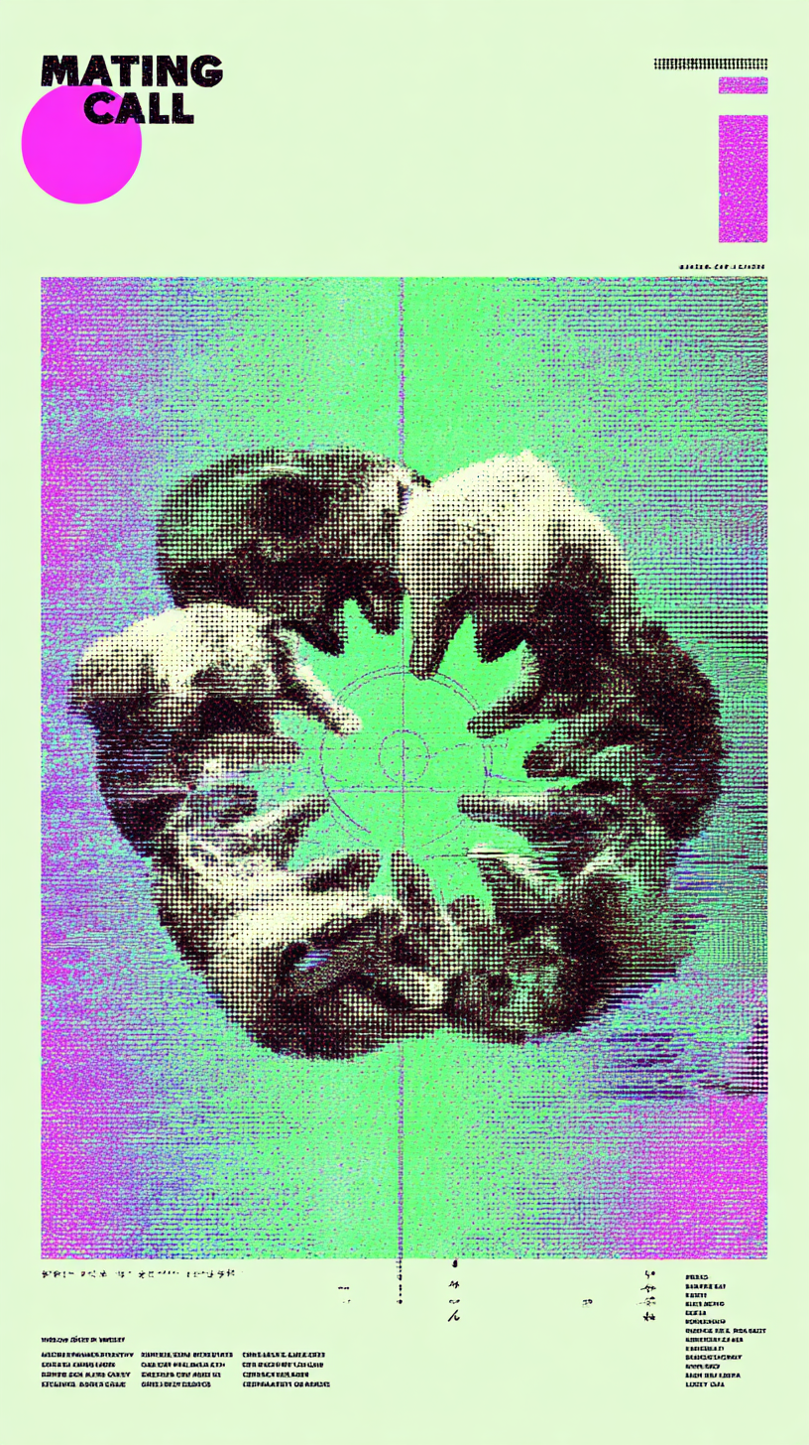
User Journey: From Questionnaire to Courtship
Participants move through a carefully choreographed experience that transforms personal data into physical performance:
01
Generate Your Mating Signature
Complete a satirical questionnaire with 10 questions that probe desire, presentation, and social performance through absurdist prompts.
02
Receive Custom Sound & Pose Sequence
The system produces your unique "mating dance" — a call-and-response ritual tailored to your algorithmic archetype.
03
Perform for Evaluation
MoveNet tracks your movements in real-time, scoring accuracy and providing immediate audio-visual feedback on performance quality.
04
Reveal Your Match
Successful performances unlock full profile information, transforming data into connection through embodied ritual.

Slide 5
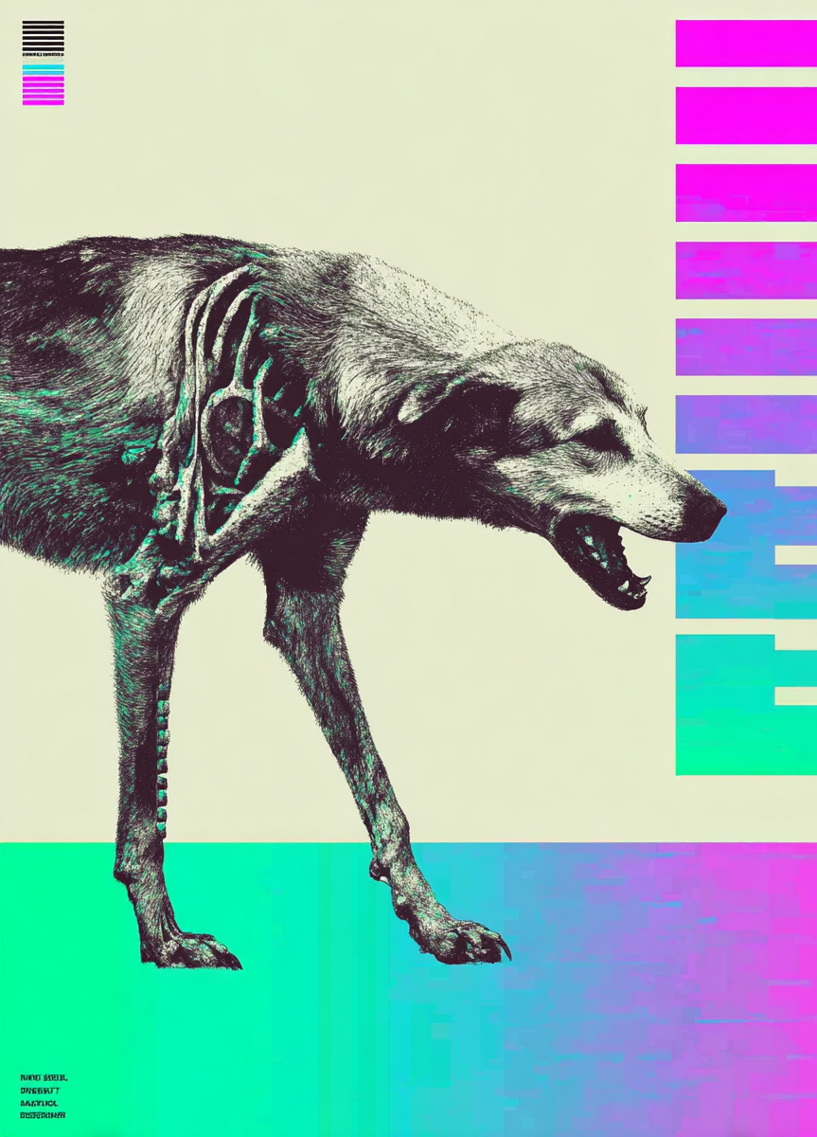




Machine Learning & Interaction Pipeline
Three stages of Interactive ML drive the experience, creating a continuous feedback loop between user input, algorithmic processing, and embodied output:
Personalization
Wekinator maps questionnaire responses to unique mating calls and movement archetypes using supervised learning.
Generation
MoveNet and TouchDesigner generate pose sequences — your algorithmic "dance" — complete with visual and sonic choreography.
Performance Evaluation
MoveNet regression scores match accuracy between expected and performed movements, providing real-time audiovisual feedback.
System Architecture: OSC protocol enables seamless communication between Max/MSP (audio), TouchDesigner (visuals), and Python (ML models), creating a unified responsive environment.
Mating Call

Slide 6
User Journey: From Questionnaire to Courtship
PERSONALIZATION
01
02
Questionnaire
Wekinator
Max/MSP Sound Algorithm
MoveNet in TouchDesigner
10 questions, 4 options each
40 input values
10 sound components, 4 options each
40 output values
10 poses, 10 in each sequence, 6 archetypes
PERFORMANCE
03
04
User performance
MoveNet in TouchDesigner
Feedback
10 body trackers
10 inputs
1 output (accuracy %)
IML
Audio feedback (3 components)
Visual feedback (2 components)

Slide 7




Project Objectives
Main Objectives
Sub-Goals
Connect self-identification, bodily expression, and social performance in a unified interactive system.
Build robust user profiling via satirical questionnaire
Generate dynamic call-dance archetypes
Translate digital dating rituals into physical gestures that expose algorithmic logic.
Design immersive app-like visual interface
Implement real-time feedback for performance success
Use humor and exaggeration to critique algorithmic intimacy and performative identity.
Body
Sound
Physical expression
Audio generation
Data
Feedback
Algorithmic translation
Real-time evaluation
Mating Call

Slide 8

Technical Setup
Software Stack
Hardware Requirements
Max/MSP — Audio synthesis and mating call generation
Laptop with sufficient GPU for real-time ML inference
Wekinator — Machine learning for personalization
HD camera for motion capture
TouchDesigner — Visual feedback and interface design
Microphone for audio input
Optional: Kinect for enhanced depth sensing
Python (OSC) — System integration and communication
Projector for installation exhibition
MoveNet — Pose estimation and performance tracking
Real-time OSC communication links sound generation in Max with motion analysis in TouchDesigner, creating seamless multimodal feedback that responds instantaneously to participant performance.
Mating Call

Slide 9
Production Timeline
Fall 2025 Development Schedule
Week
Task
Outcome
Oct 23
Submit proposal
Pipeline sketch ideation
Oct 30
Oral presentation
Feedback + demo (WIP MoveNet + Max)
Nov 5-10
Data collection & labeling
30-50 takes per archetype
Nov 11-20
Integration & feature engineering
Classifier v1 + similarity meter
Nov 21-30
Prepare final presentation
Polished demo
Dec 11
Final report
Full documentation
Oct
1
Proposal & ideation
2
Early Nov
Data collection
Mid Nov
3
ML integration
4
Late Nov
Refinement
Dec
5
Final delivery
Mating Call

Slide 10
References & Inspirations
This project builds upon recent scholarship in interactive machine learning, embodied interaction, and AI-mediated performance:
Caramiaux & Donnarumma (2020)
Plant et al. (2020)
Scurto et al. (2017)
IML for Embodied Interaction Design: Movement-based IML tools that enable designers to work directly with gestural input.
Motion-Sound Mappings for Music: Multimodal inputs for interactive audio — creating expressive sonic responses to physical gesture.
AI in Music & Performance: ML as artistic collaboration — exploring co-creative relationships between human performers and intelligent systems.
Visi & Tanaka (2020)
Chen et al. (2023)
Interactive ML of Musical Gesture: Gesture tracking and learning systems that adapt to individual performer styles.
Emotional Responses in AI Installation Art: Emotional feedback loops in participatory AI-driven experiences.
Mating Call

Slide 11
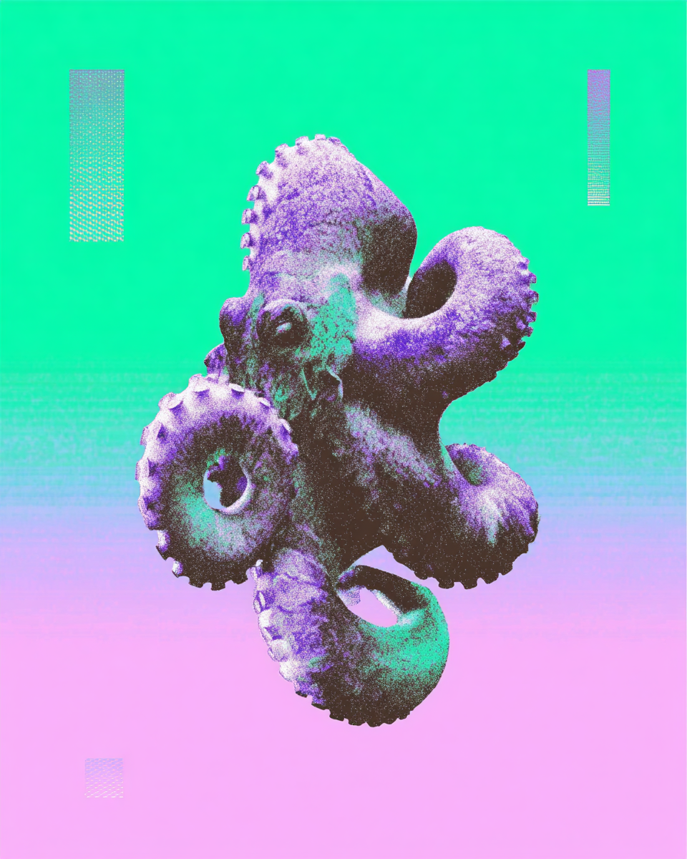
Conclusion & Future Outlook
"Mating Call" transforms digital dating into an embodied art form, making visible the performative labor hidden within algorithmic matchmaking. The project aims to spark dialogue on how technology shapes desire, identity, and human connection.
Next Steps
Continue data collection & classifier tuning with diverse participants
Design final installation layout for exhibition context
Implement real-time matchmaking demo for final presentation
Document participant responses and critical reception
Mating Call

